Slide 1














Case Project- Banking Data Analysis
Presented by Abhinav Singh

Slide 2
Dataset Description
Term deposits serve as a significant revenue stream for banks, representing cash investments held within financial institutions. These investments involve committing funds for a predetermined period, during which they accrue interest at an agreed-upon rate. To promote term deposits, banks employ various outreach strategies including email marketing, advertisements, telephonic marketing, and digital marketing.
Despite the advent of digital channels, telephonic marketing campaigns persist as one of the most effective means of engaging customers. However, they necessitate substantial investment due to the requirement of large call centers to execute these campaigns. Therefore, it becomes essential to pre-identify potential customers likely to convert, enabling targeted outreach efforts via phone calls.
The data is related to direct marketing campaigns (phone calls) of a Portuguese banking institution. The goal of this project is to analyze the data and to predict if the client will subscribe to a term deposit.

Slide 3
Data Description:
The file banking_data.csv contains 45,211 rows and 18 columns ordered by date (from May 2008 to November 2010)
The columns consist of:
age: This column represents the age of the bank client. It's a numeric variable indicating the age in years.
job: This column indicates the type of job the client has. It's a categorical variable with options such as "admin.", "unknown",
"unemployed", "management", etc.
marital_status: This column represents the marital status of the client. It's a categorical variable with options such as "married", "divorced",
or "single".
education: This column indicates the level of education of the client. It's a categorical variable with options such as "unknown",
"secondary", "primary", or "tertiary".
default: This column indicates whether the client has credit in default. It's a binary variable with options "yes" or "no".
balance: This column represents the average yearly balance in euros for the client. It's a numeric variable.
housing: This column indicates whether the client has a housing loan. It's a binary variable with options "yes" or "no".
loan: This column indicates whether the client has a personal loan. It's a binary variable with options "yes" or "no".

Slide 4
contact: This column represents the type of communication used to contact the client. It's a categorical variable with options such as "unknown", "telephone", or "cellular".
day: This column represents the last contact day of the month. It's a numeric variable.
month: This column represents the last contact month of the year. It's a categorical variable with options such as "jan", "feb", "mar", etc.
duration: This column represents the duration of the last contact in seconds. It's a numeric variable.
campaign: This column represents the number of contacts performed during this campaign and for this client. It's a numeric variable.
pdays: This column represents the number of days that passed by after the client was last contacted from a previous campaign. It's a numeric variable where -1 means the client was not previously contacted.
previous: This column represents the number of contacts performed before this campaign and for this client. It's a numeric variable.
poutcome: This column represents the outcome of the previous marketing campaign. It's a categorical variable with options such as "unknown", "other", "failure", or "success".
y: This column is the target variable and indicates whether the client has subscribed to a term deposit. It's a binary variable with options "yes" or "no".

Slide 5
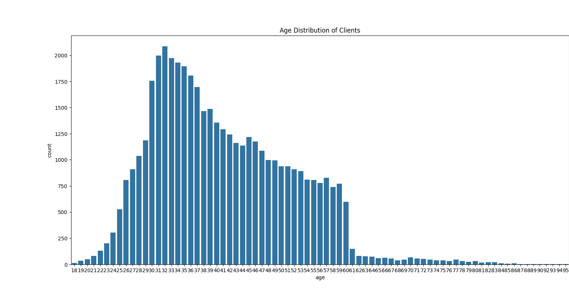
Age Distribution of Clients
As we can observe from the graph, most of the clients are middle aged, with the mean age being around 41

Slide 6
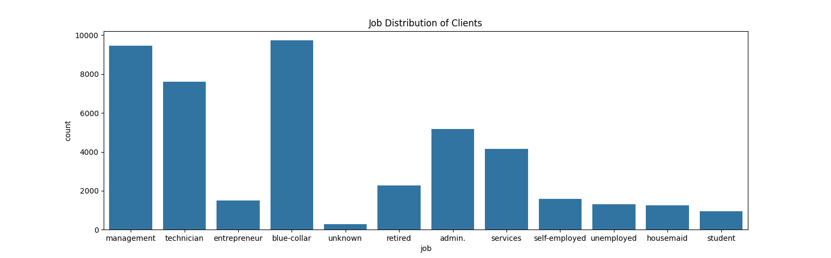
Job Distribution of Clients
As we can observe from the graph, most of the clients are involved in blue collar jobs preceeded by management jobs.

Slide 7
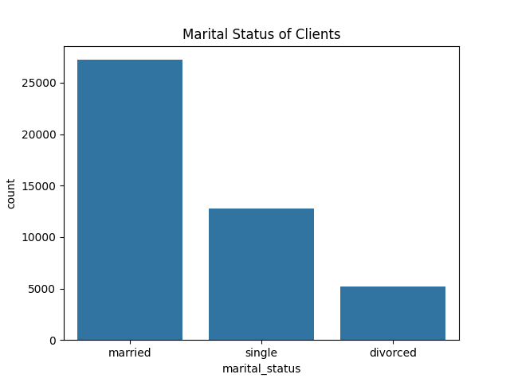
Marital Status of Clients
As we can observe from the graph, most of the clients are married.

Slide 8
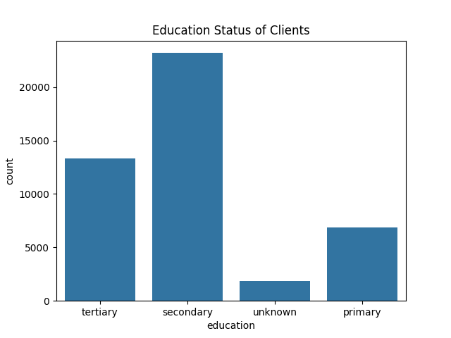
Level of Education of Clients
As we can observe from the graph, most of the clients have completed secondary education

Slide 9
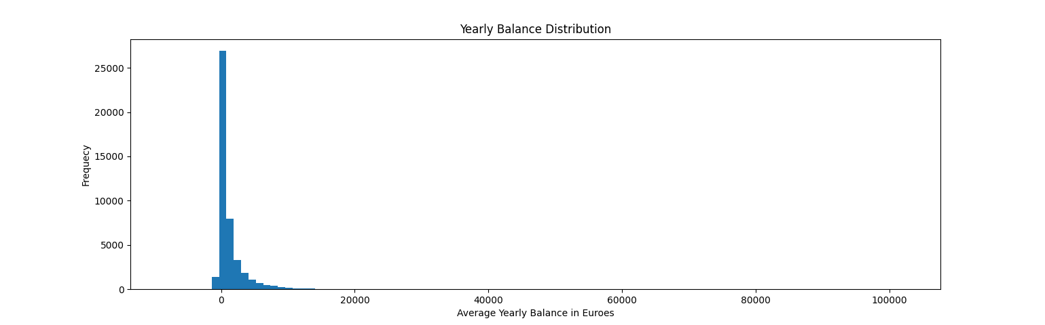
Yearly Balance Distribution
The mean yearly balance of clients is around 1362 euros. Very few clients have balance above 20,000

Slide 10
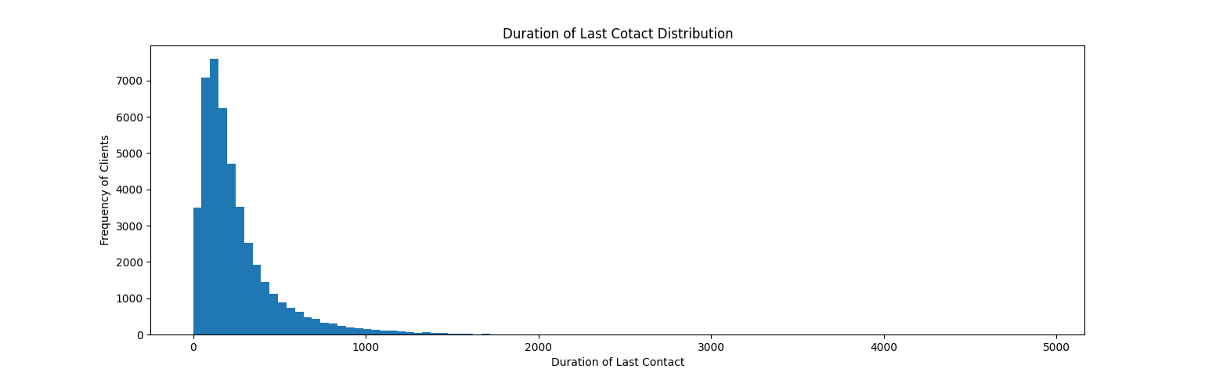
Duration of Last Contact
The mean duration of last contact with clients is around 4 minutes. It ranges from 0 minutes all the way to 82 minutes.

Slide 11
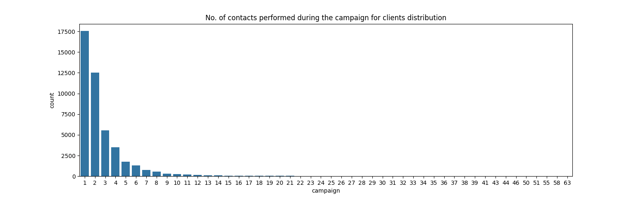
Number of contacts performed during the campaign for clients
For most of the clients, no contacting was done. Maximum of 63 contacting was done for some clients.

Slide 12
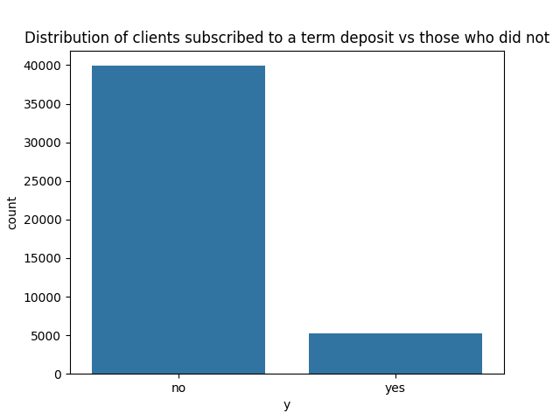
Final distribution of clients who subscribed to a term deposit
We can observe that after the contacting, eventually around 11.7% of clients chose to take the term deposit.

Slide 13
Trying to relate the outcome of term deposit with other factors
By using various tools of data analysis, we can try to find the factors that had a significant impact on the likeliness of whether a client takes a term deposit or not.
Here, we use the correlation matrix to achieve our goal. First, we convert all the column values into categorical data, so that correlation can be established by using:
df[i] = df[i].astype('category').cat.codes
where ‘i’ represents different columns in our data.
Finally, we plot the correlation matirx and observe the changes.

Slide 14
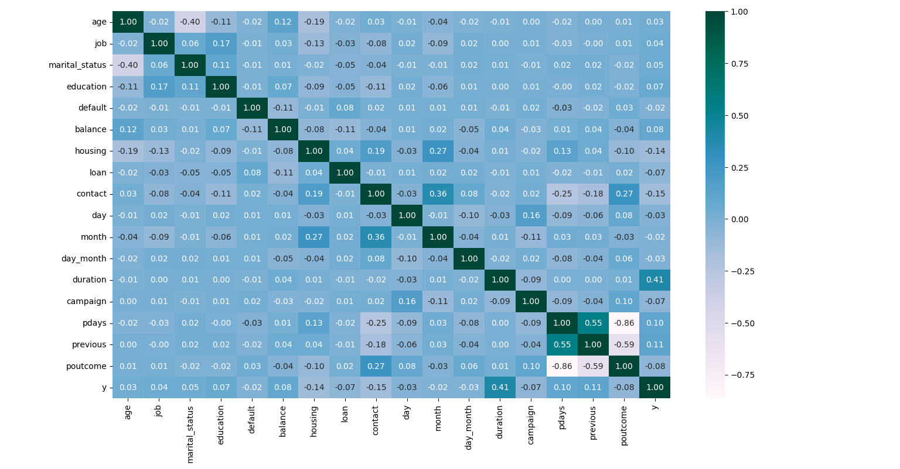
Correlation Matrix

Slide 15
Conclusion
In the correlation matrix, if we go through the ‘y’ column, which represents the outcome of term deposit, we can observe that most of the columns have little to no relation with it, as their values are between -0.2 to 0.2
But the duration column has 0.41 value, which indicates moderate correlation.
So in conclusion, we can say that the likeliness of the client taking term deposit might be related to the duration of last contact with them. More the duration, higher the chance of them taking the term deposit
The result makes sense in real-life scenario as the higher duration of contact might suggest that the client is interested in the service

Slide 16
Thank you very much!

